Slide 1
CCD Data for SNU_AO class
Yoonsoo P. Bach

Slide 2
Contents
About CCD data
Before CCD

Slide 3
History of CCDs
First concept design: 1969-10-17 @ Bell labs (NJ, US)
First published: 1970 Apr
First patent: 1971 (see figure below)
1970s: NASA JPL started developing astronomical CCDs.
First light: 1976 by Brad A. Smith @ Mt. Bigelow with JPL engineer Jim Janesick.
IRAF design phase: 1981-1986
2009 Nobel (physics; half) to 2 CCD inventors.
Reference: Sara Turriziani (2019), AAS HAD, 50 Years of CCDs
https://aas.org/posts/news/2019/10/month-astronomical-history-50-years-ccds
Image from the patent for using CCDs in imaging filed by Tompsett in 1971. (U.S. Patent 4,085,456)

Slide 4
CCD data format
CCD data contains at least 2 parts: header and data.
Since 1990s, the only standard file format is FITS (Flexible Image Transport System)
Initial release 1981
Current FITS version 4.0 (2016; IAU FITS Working Group)
Old IRAF used, e.g., .imh format.

Slide 5
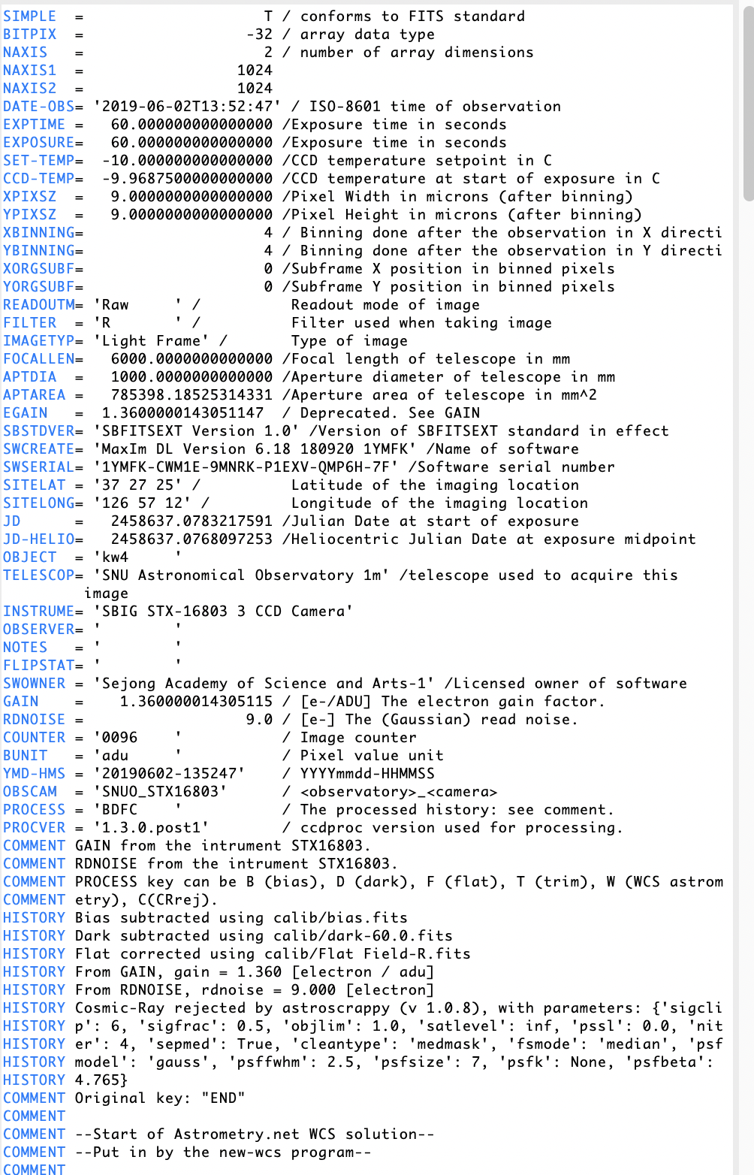
CCD data format
CCD data contains at least 2 parts: header and data.
Header: Information about the file.
<keyword>: max 8 characters
<value>: float, string, etc
<comment>: should not be too long. Format: [unit] explanation
You will always see: SIMPLE, BITPIX, NAXIS
Important standard keywords
DATE-OBS: Standard says <YYYY-MM-DD>T<HH:MM:SS> in UT (start of exp)
EXPTIME: Exposure time (usually in sec); some people also use EXPOS(URE)
OBJECT: The target of observation
GAIN/RDNOISE: Gain (e/adu) and readout noise (e). EGAIN is non standard.
Also important
HISTORY/COMMENT: tells you what have been done to this image.
FILTER, FILT, …: Filter information.
IMAGETYP: bias/dark = Dark Frame, flat/object/etc : Light Frame

Slide 6

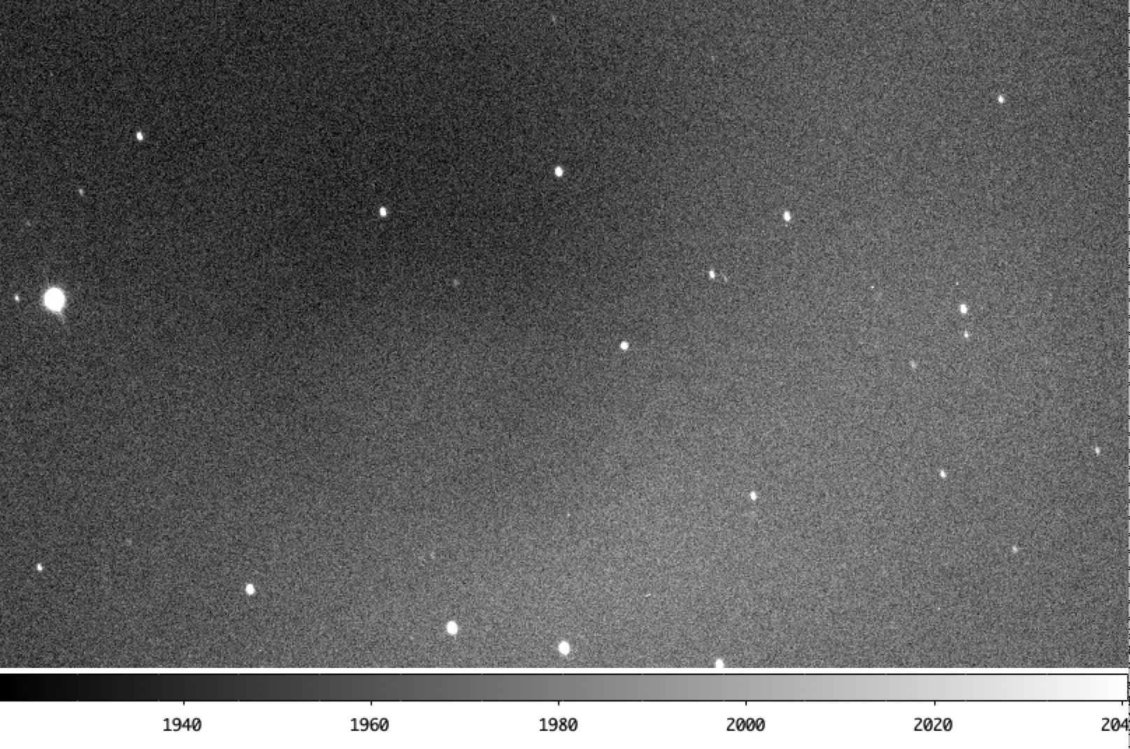
CCD data format
3-D (IFU)
(NGC 5728, VLT MUSE Narrow Field Mode
Courtesy of Jaejin Shin to Yoonsoo bach, 2020-04-14)
CCD data contains at least 2 parts: header and data.
Data: N-D data
2-D
(1999 KW4, SNUO 1m photometry; 2019-06-02)

Slide 7
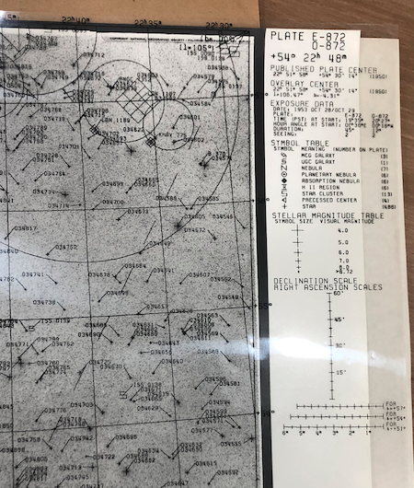
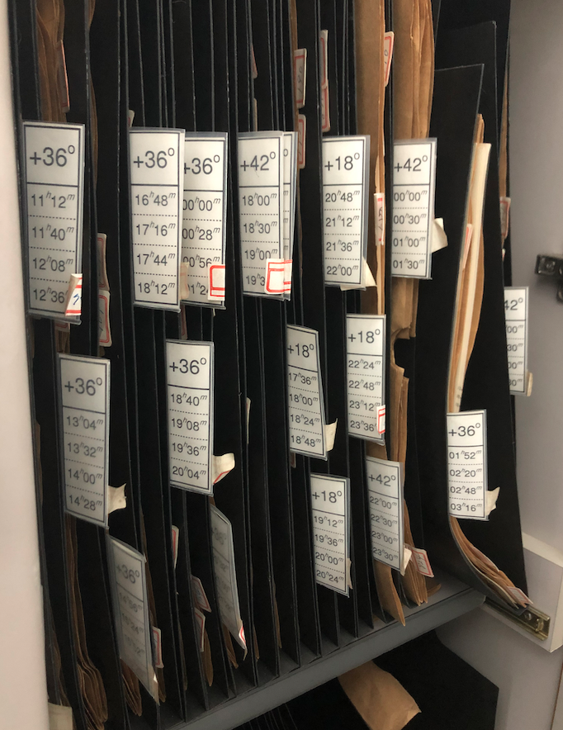

Digression
SNU astro library,
from Ohio State University Radio Observatory 1979, A. S. Dixon et al.
Before CCD…

Slide 8
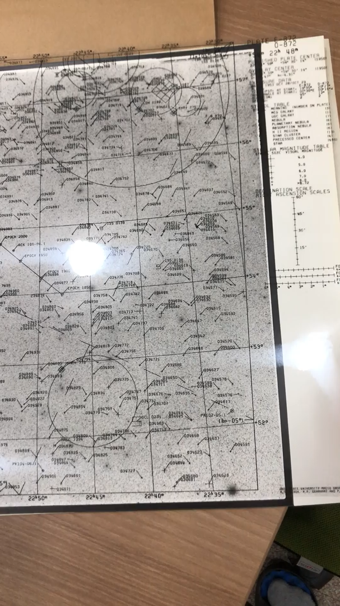
Matching the sky image with known catalog
pixel coordinate ⇔ RA/DEC etc
The functional form for this conversion is called WCS (World Coordinate System)
Quick Quiz:
Stars are point sources.
Why are bright stars larger in the image?

